Slide 1

BANK STOCK PRICE PREDICTION AND MODEL COMPARISON
Data Mining and Machine Learning (WS 2024/25)
Supervised By:
Prof.Christian Groth
Presented By:
Manoj Sundar Ravichandran
Data Mining and Machine Learning

Slide 2
AGENDA
Stock Price?
Bank Stock Price Impact Country Economy
Our Mission and Motivaiton
Why Deutsche Bank ?
Dataset
Exploratory Data Analysis(EDA)
Data Preprocessing
Model-1 Results and Evaluation Metrices
Model-2 Results and Evaluation Metrices
Performance justification
Hybrid Model
Challenges

Slide 3

Manoj Sundar Ravichandran | Data Mining and Machine Learning | WS 2024/25

Slide 4
BANKS STOCK PRICE IMAPCT A COUNTRY ECONOMY
Bank's Ability to Lend
Impact on Tax revenue
Public bailouts in crises
Manoj Sundar Ravichandran | Data Mining and Machine Learning | WS 2024/25

Slide 5

PROBLEM STATEMENT
Accurately predicting stock prices is crucial for investors, traders and financial analysts.
Reason : Dynamic, unpredictable and non-linear in nature.
OUR GOAL
Predict Next Day Deutsche Bank's stock price using historical data and analyze its performance across different models.
MOTIVATION
Informed Investment Decisions
Risk management
Market Trends
Strategic Advantages for financial institutions
Economic Forecasting
https://images.app.goo.gl/VWhCszUngYMyxVm46

Slide 6

WHY DEUSTCHE BANK ?
Deutsche Bank is a major financial institution with a wide range of services including investment banking asset management and retail banking.
Reflects broader macroeconomic trends, financial market conditions, and the health of the banking sector.
Predicting its stock price helps assess the financial industry's overall stability and performance, which affect both the bank and the market at large.
ThePhoto by PhotoAuthor is licensed under CCYYSA.

Slide 7
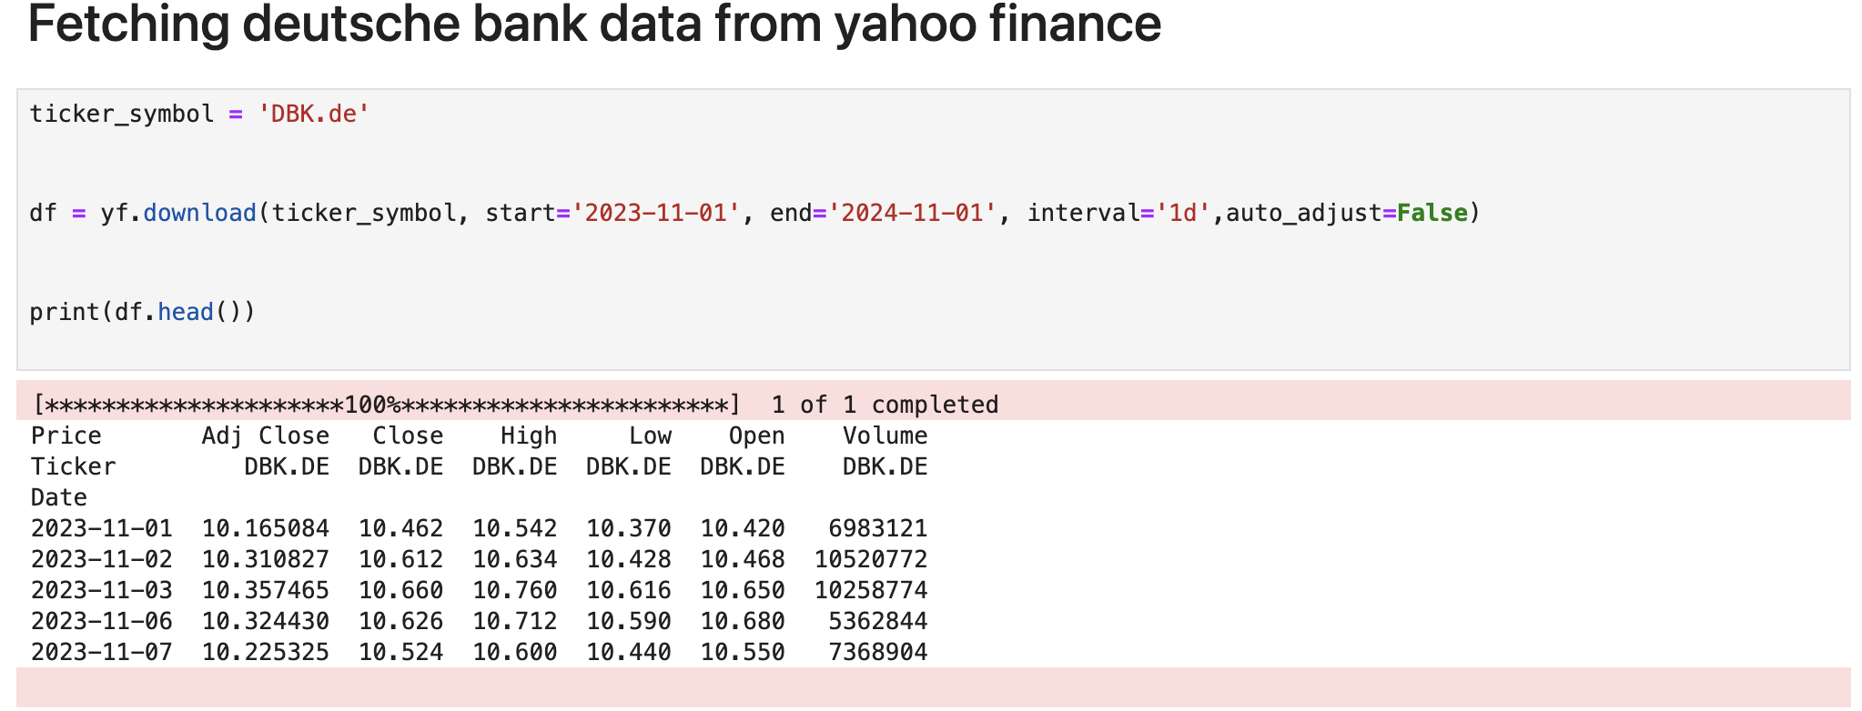
DATASET
Source : Yahoo Finance
Timeframe : Nov 2023 – Nov 2024

Slide 8
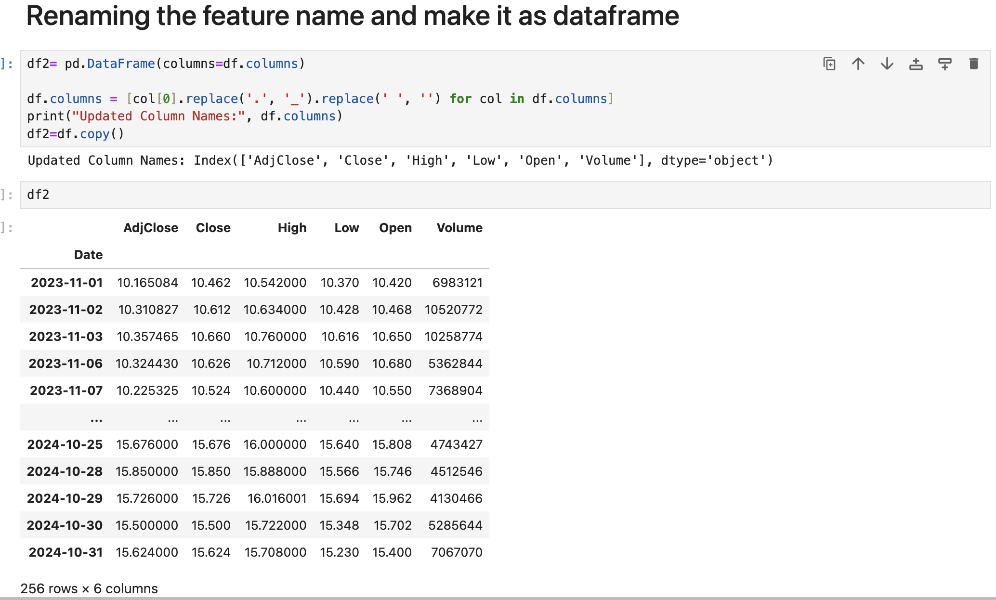

Slide 9
FEATURES
In this data there are mainly 2 features in original data :
1. Temporal Feature : Date
2. Numerical Features : Open, High, Low, Close, AdjClose, Volume
UNDERSTANDING OF DATA
AdjClose: Closing price of stock after adjustment for events like dividends, stock splits, and new stock offering.
Close : It is the final value of the stock for the day
High : It is highest price at which stock was traded during specific day
Low : It is lowest price at which stock was traded during specific day
Open : The price of stock at the beginning of trading session.
Volume: It is total number if shares traded during specific period

Slide 10
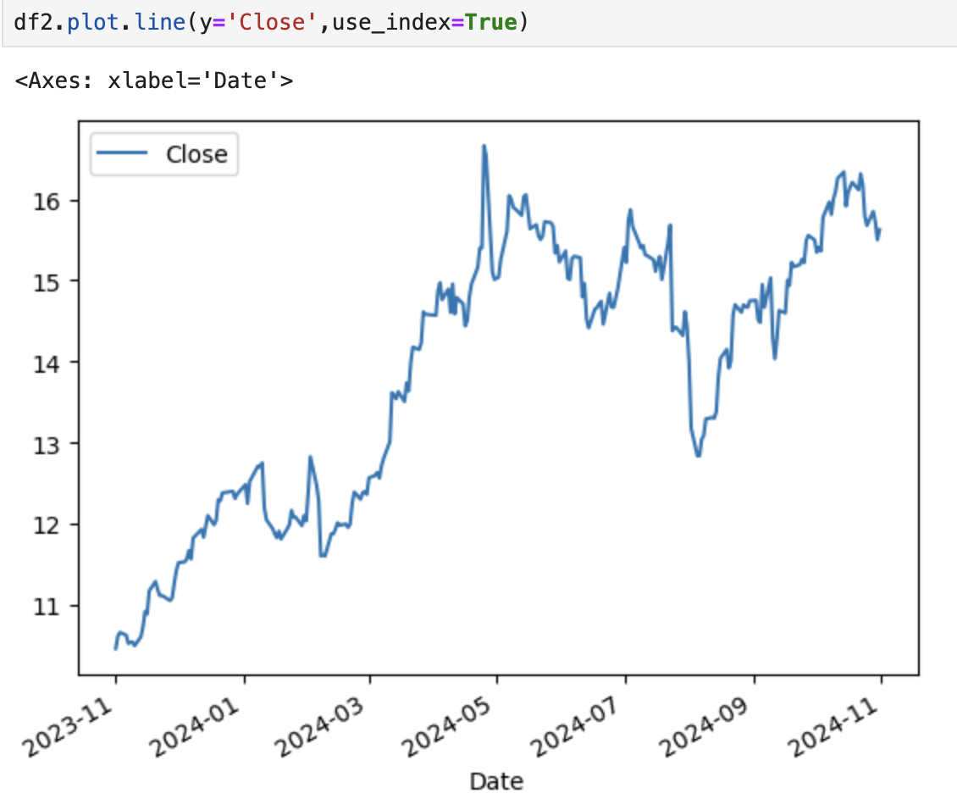
Rows : 256
Columns : 6
Target Column: Close (price)

Slide 11
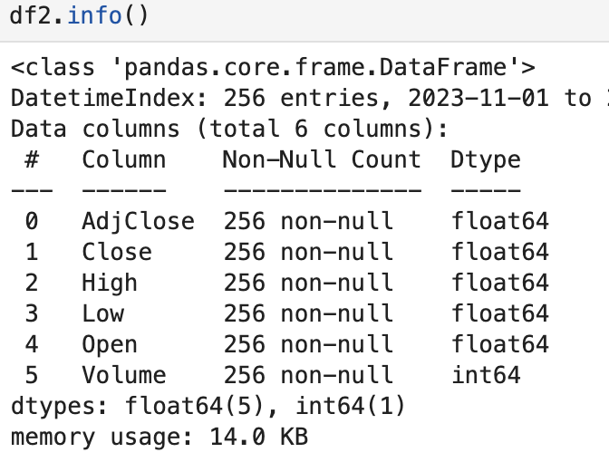
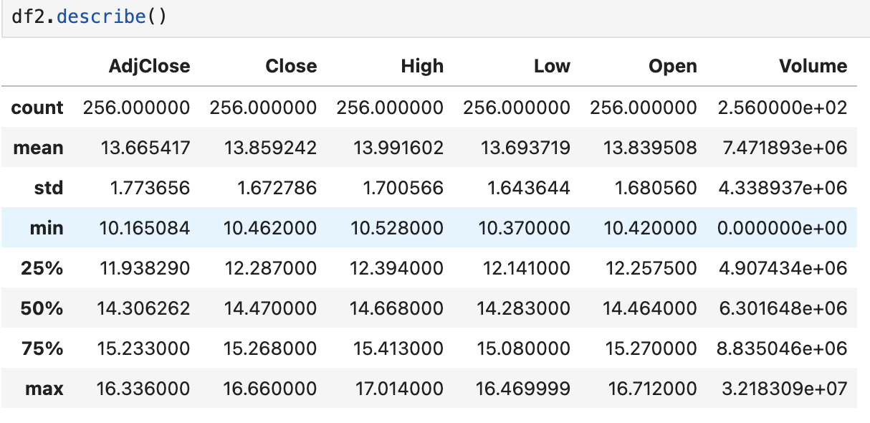
SUMMARY OF DATAFRAME STRUCTURE
DESCRIPTIVE STATISTICS

Slide 12
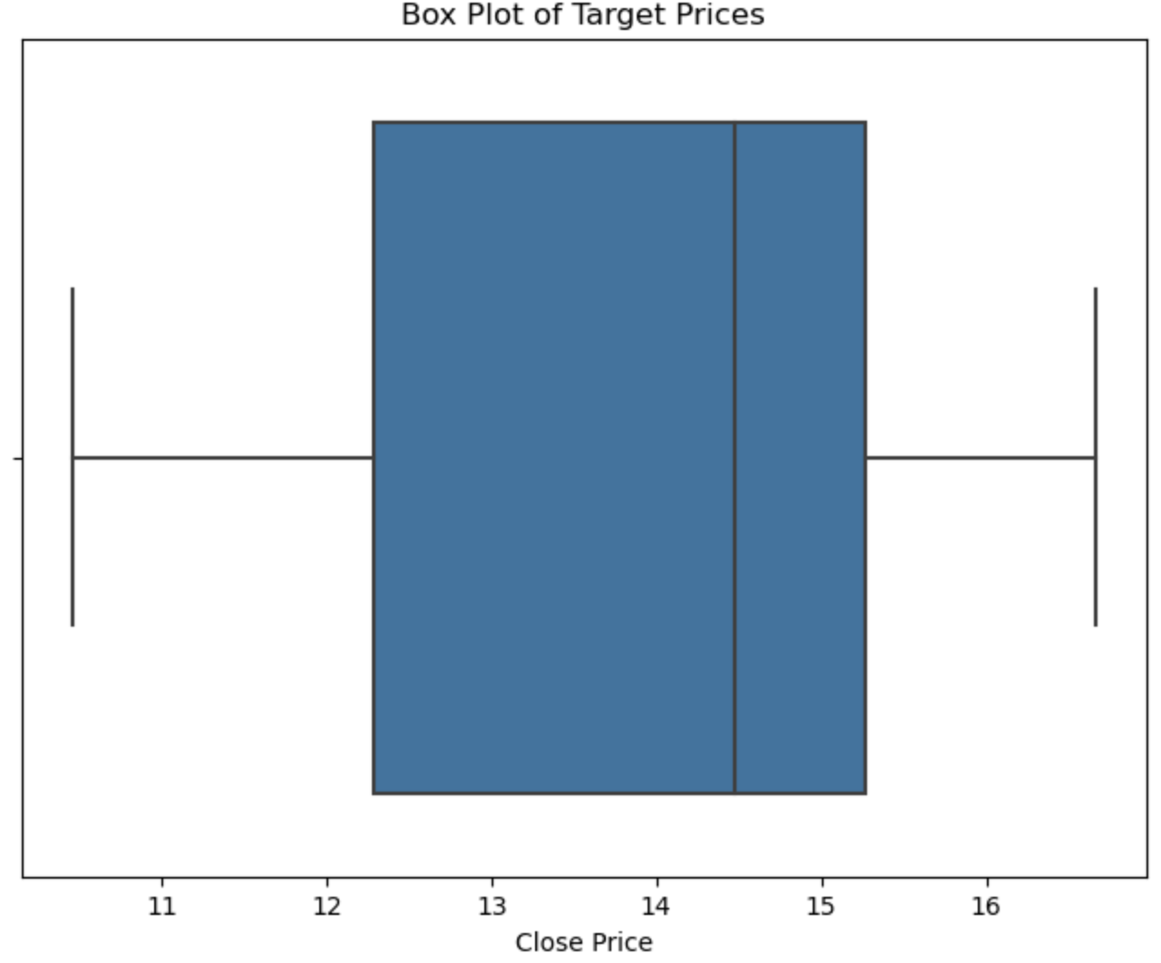
OUTLIERS
Creates a boxplots to Visualize the distribution of close prices and identify the potential outliers
Results : there is no outliers

Slide 13
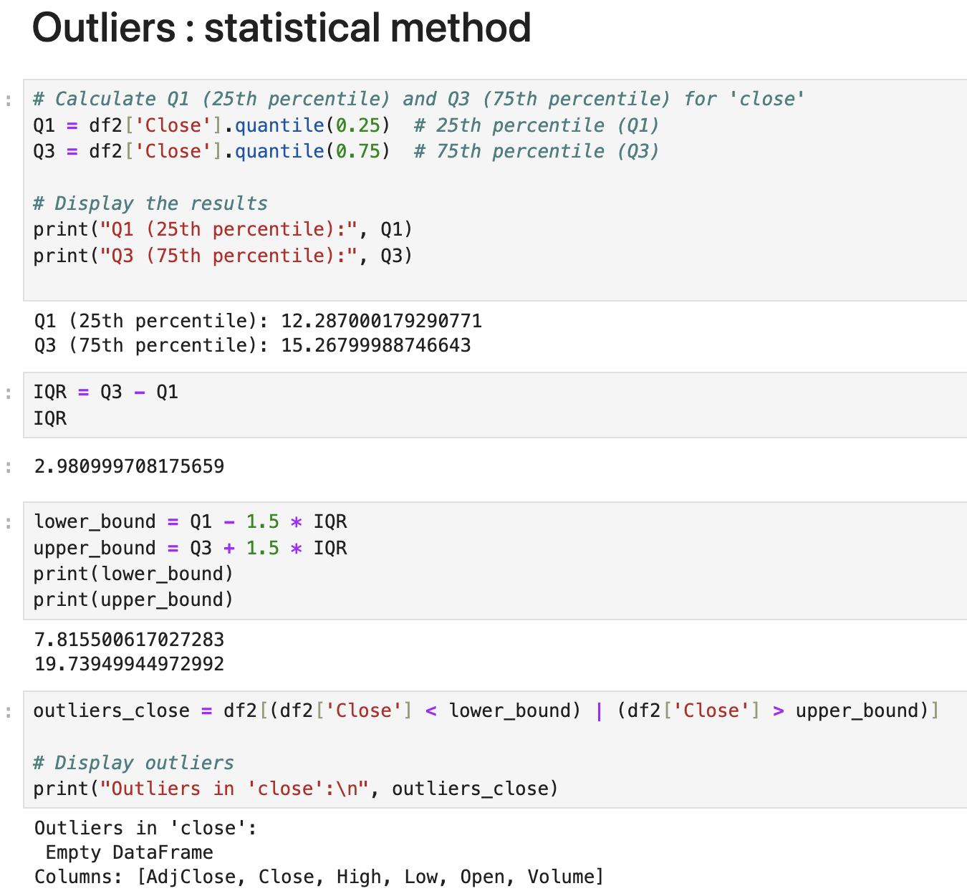
OUTLIERS USING IQR

Slide 14
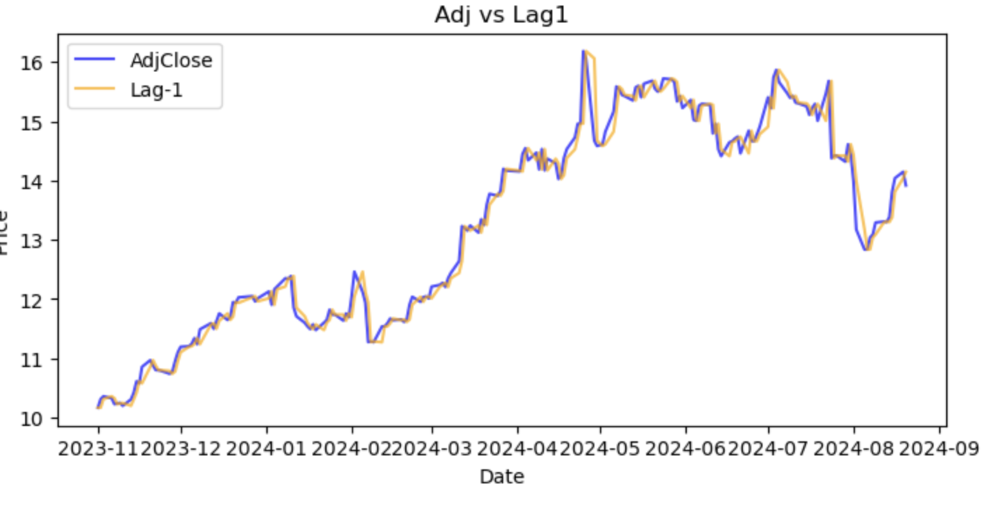
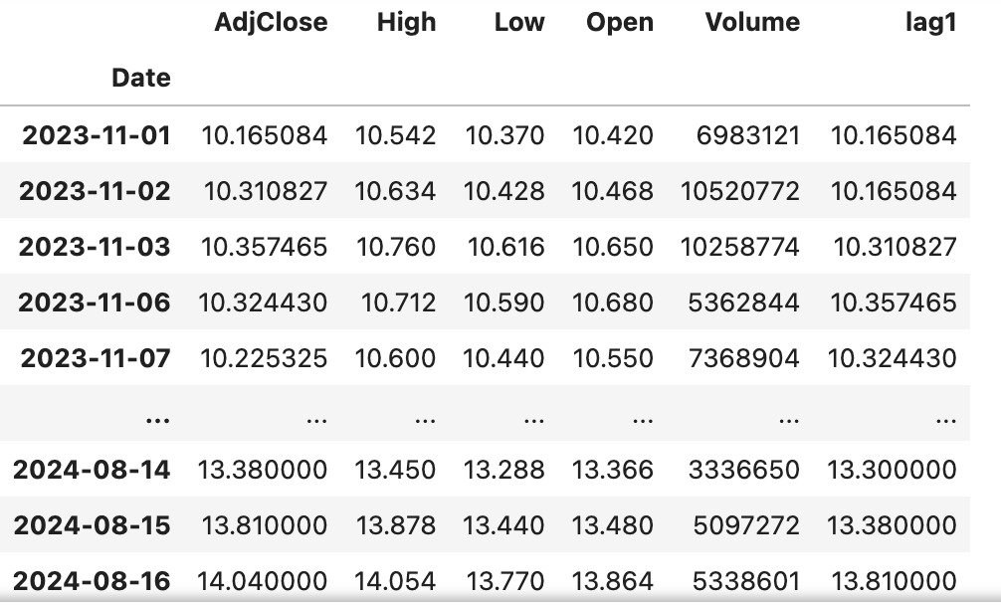
ENGINEERED FEATURES
Lag feature : lag feature is a time shifted version of a variable. Representing its past values.

Slide 15
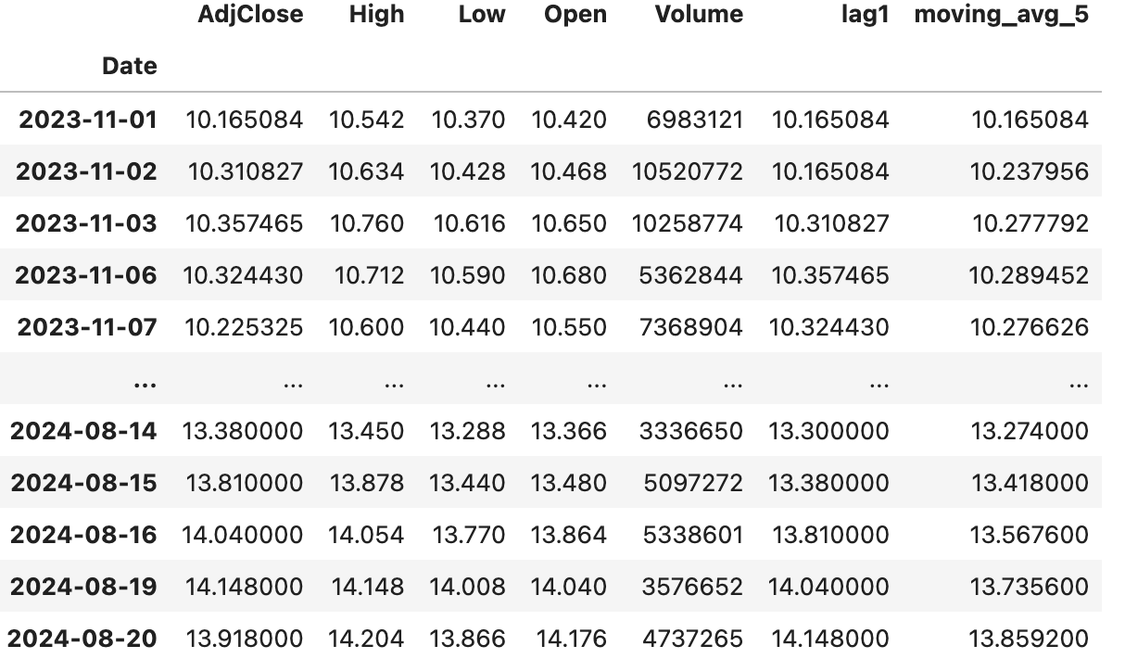
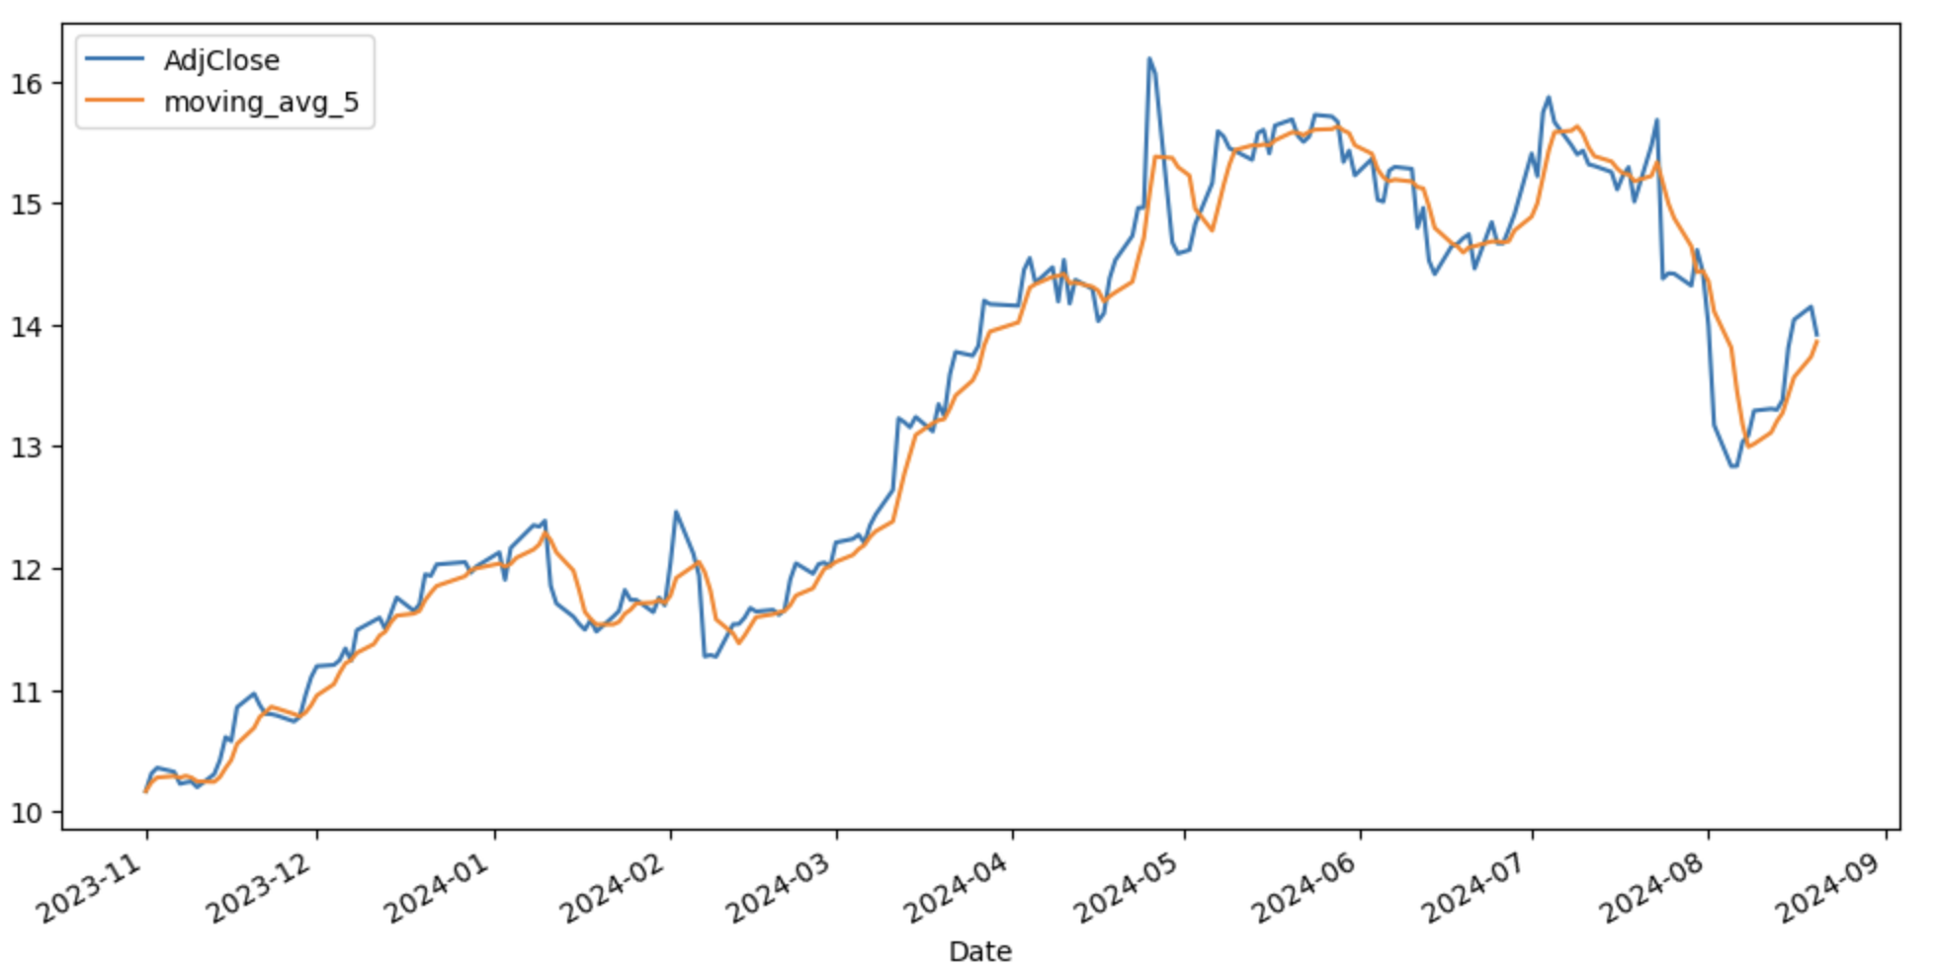
ENGINEERED FEATURES
Moving average: Calculates the average of the past consecutive data points. It smooths short-term fluctuations and highlights trends.

Slide 16
Selected only the engineered features and scaled the features using "Standard Scaler".
Also use seperate standard scaler for target value "Close".
Trained the linear model with scaled feature and scaled target.
Looped through the scaled test data to make prediction.
Finally inverse the scaled prediction to original values.
MODEL –1 : LINEAR REGRESSION

Slide 17
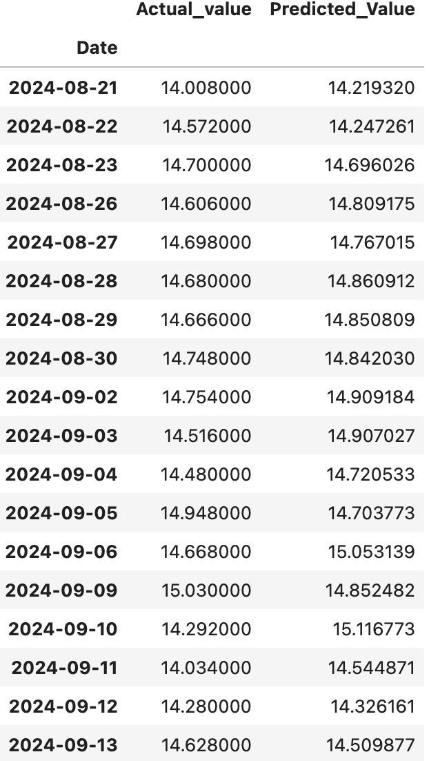
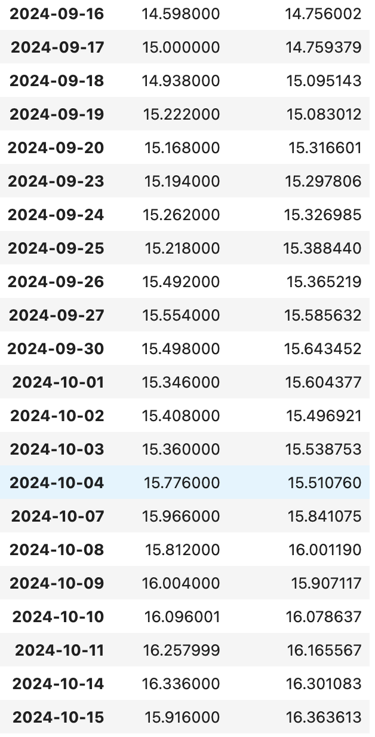
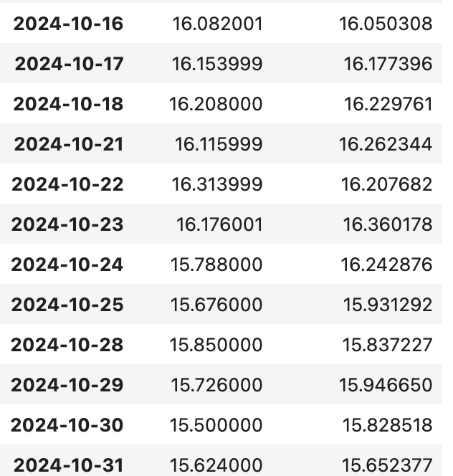

Slide 18
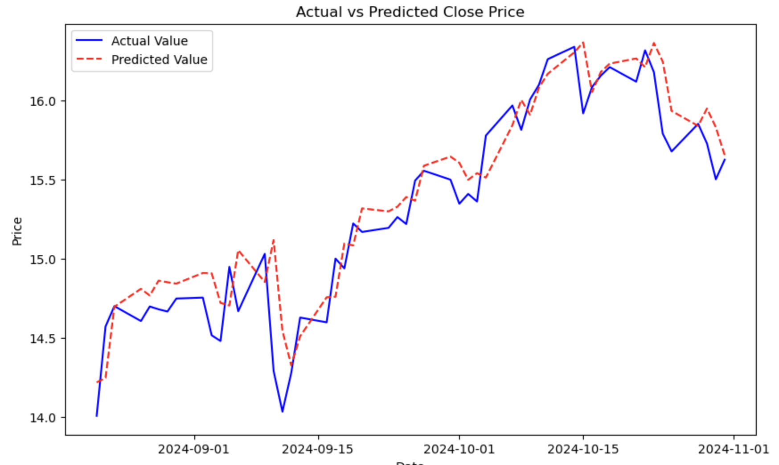

Slide 19
Mean Absolute Error (MAE) : 0.1819
Mean Squared Error (MSE) : 0.0554
Root Mean Squared Error (RMSE) : 0.2354
R-squared (R-2) 0.8676
MODEL –1 : EVALUATION METRICES
Manoj Sundar Ravichandran | Data Mining and Machine Learning | WS 2024/25

Slide 20
MODEL –2 : LSTM
LSTM we use MinMax scaler for scaling the features ranges between 0 and 1
Also use separate MinMax scaler for target value "Close"
LSTM model works on sequence of data instead of feeding indvidual data points
Setting up the trainer using pl.trainer with epochs ,GPU and etc

Slide 21
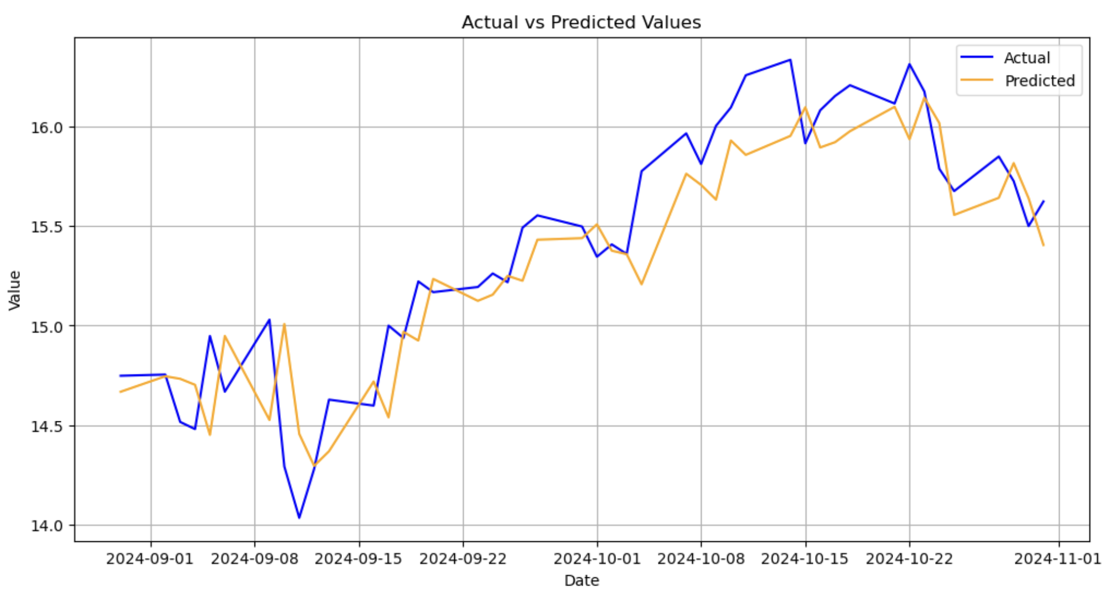

Slide 22
MODEL-2 : EVALUATION METRICES
MEAN SQUARED ERROR (MSE) : 0.0722
MEAN ABSOLUTE ERROR (MAE) :0.2113
ROOT MEAN SQUARED ERROR (RMSE) : 0.2686
R-SQUARED (R-2) : 0.8104

Slide 23
WHY LSTM ACCRUACY IS LESSER THAN THE BASE MODEL ?
Linear Regression align well with its linear assumption, and reduce noise, resulting in better performance
LSTM leads to lower score because of feeding all features including noisy ones, likely diluted its effectiveness.
HOW TO IMPROVE LSTM'S PERFORMANCE
More precise Feature selection.
Experiment more with engineering features.

Slide 24
CURRENT TREND METHOD : (HYBRID MODEL )
LSTM + LINEAR REGRESSION
Method 1: Sequential Combination
Method 2 : parllel Combination

Slide 25
WHERE LINEAR REGRESSION HELPS ?
Linear regression helps for better static or engineerd features
Fast convergence
Residual Corrections
WHERE LSTM HELPS ?
Sequential dependencies
Non-linear interaction
Dynamic patters

Slide 26
CHALLENGES IN THE HYBRID MODELS
Data Preparation
Integration
Model Complexity

Slide 27
CHALLENGES IN STOCK PRICE PREDICTION
Market Complexity and Non-stationary
High Volatility

Slide 28

Thank You !

